Slide 1
Winter Term 22/23 Graph Neural Networks for Knowledge-Graph Systems Org & Introduction
Prof. Dr. Holger Giese (holger.giese@hpi.uni-potsdam.de)
Christian Medeiros Adriano (christian.adriano@hpi.de) - “Chris”
Matthias Barkowsky (matthias.barkowsky@hpi.de)
Iqra Zafar (iqra.zafar@hpi.de)

Slide 2
Key Facts
Weekly Hours: 4
Credit Points: 6
Teaching Form: Project Seminar
Enrolment Type: Compulsory Elective Module (“Wahlpflichtmodul”)
Course Language: English
Study Programs and Modules:
IT-Systems Engineering MA
Mandatory module : „IT-Systems Engineering Analysis“
Mandatory module: „IT-Systems Engineering Design“
Specialization module(s): „Software Architecture & Modeling Technology“
Data Engineering MA
Digital Health MA

Slide 3
Dates
Enrollment period: 01.10.2022 - 31.10.2022
Introductory meeting: 18.10.2022 [NOW]
Meetings:
Lectures - scheduled
Update meetings – on demand, usually weekly
Final Presentations at end of the semester: To be decided
Presentations will be at the lecture room and the participants will be able to join via Zoom.

Slide 4
Communicantion Plan
Motive | Content | Medium
Artifacts | Source code, Data Documentation, Wiki | Github - https://github.com/orgs/hpi-sam/
Papers | Copyrighted material | Zotero
Messaging ad hoc | Questions, Suggestions, Sharing | Our Slack group: Send email to christian.adriano@hpi.de
Official communications | Schedule, Orientations, Administrative issues | Email christian.adriano@hpi.de
Meetings | Lectures, Status, Work meetings | Zoom, Skype
Emergency | Call, SMS, messaging | Chris mobile number (check Chris’ Slack profile)

Slide 5
Project Proposal
Team size: up to four (preferred)
Project proposal in two stages:
1- State-of-art (1 page, double column) – ~ in approx. 6 weeks
covering at least 10 well-selected papers per person
2- Proposal - first draft ~ in approx. 8 weeks
Detail the problem (what is it? why should I care?, why is it challenging?)
Describe the scenario (source, size, main features, cite any papers that used it)
Determine the methods that you plan to use (preliminary insights, it might change)
Discuss how you will evaluate your results (benchmarks, baselines, null-models)

Slide 6
Roadmap (1/2)
Project Phase 1: Learn fundamentals - Lectures
Goal: learn fundamentals
Deadline: Mid-End of November
Two lectures per week (Tuesday and Wednesday)
Project Phase 2: Present Proposal - Reading and Writing
Goal: learn about the state of art of one application area
Project Phase 3: Apply a method - Coding and Evaluation
Goal: learn to apply and evaluate a method
Present update in weekly meetings (either Tuesday or Wednesday)
Final Presentations in one session in late January 2023
Submission of final report two weeks after the presentation
12 pages ACM format double column, ~ 4 pages per group member

Slide 7
Road Map (2/2)
Intro and Course Organization
Graph Metrics and Random Models
Graph Structural Features – Clustering
Generative Graph Models
Message Passing & Belief Propagation
Graph Embeddings - Message Passing
Prediction on Graphs (GCN), Graph Attention Networks
Detection of Graph Anomalies
Prediction on Spatio-Temporal Graphs
Failure Propagation on Graphs
Knowledge-Graphs Concepts
Knowledge-Graphs Applications
Week-1
Organization
Intro on Graphs
Objectives
Team building, Setup, Overview of Graph data
Week-2
Prediction on Graphs
Understand how prediction on graphs happen
Week-3
Anomalies and Failure Propagation
Phenomena of interest and available methods to reproduce and predict them
Week-4
Knowledge-Graphs
How knowledge-graphs can help prediction on graphs

Slide 8
Seminar Work, Deliverables and Grading
Seminar work alone or in groups on one selected topic/project.
Each team is supervised individually by a teaching assistant.
Weekly update meeting
Intermediary Presentations
Written deliverables: [80% of final grade]
Final report on findings
Length: 12 pages ACM Format per team
Some parts must be attributable to each individual author (~4 pages per author)
Final Presentations: [20% of final grade]
Presentation on findings
Questions and feedback for other students' presentation

Slide 9
Next Task
Send an email to christian.adriano@hpi.de
Accept invitation to Slack, Zotero, and GitHub project
Give a look at the papers on Zotero and start making a selection
Prepare to write a gist (context, problems, approaches) of two papers for next week

Slide 10
Motivation for Learning on Graphs and GNNs

Slide 11
Scenarios and Network Types
Network Types
Event graphs
Disease pathways
Knowledge-graphs
Scene graphs
Heterogeneous graphs (different types of nodes and edges)
Scenarios
Clustering in social network
Protein interaction
Cell similarity networks
Failure propagation in infrastructure networks
Fake news detection
Side-effects of drugs
Network attacks
Traffic jams

Slide 12
Types of Predictions
Node classification
What type of node is this?
Link prediction
Are these two nodes connected?
With which strength?
Graph Classification
Patterns of connectivity (motifs)
Network similarity (isomorphism)
Notes:
Leskovec, Jure, et al. "Community structure in large networks: Natural cluster sizes and the absence of large well-defined clusters." Internet Mathematics 6.1 (2009): 29-123.

Slide 13
Basic Concepts

Slide 14
Types of graphs
Directed
Undirected
Disconnected
Fully connected
A
A
A
A
B
B
B
B
C
C
C
C
D
D
D
D
Directed Acyclic Graph
Multigraph
Bipartite
Cliques
E
A
A
A
A
B
B
B
F
B
C
C
C
D
D
D
C
D
Ego network of A

Slide 15
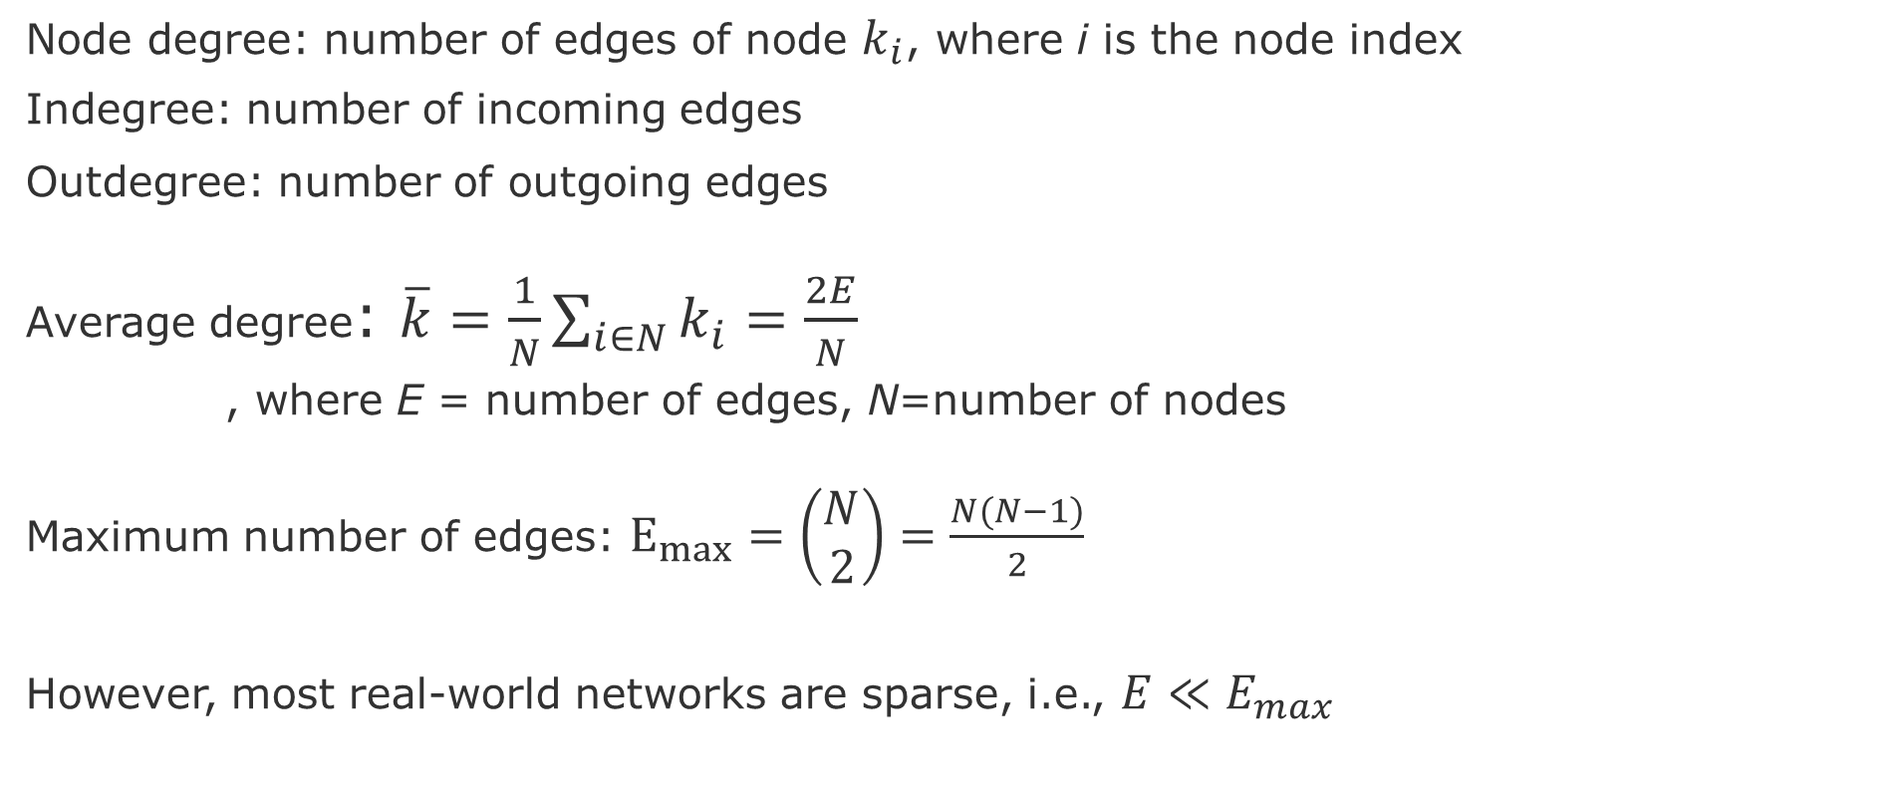
Node and Edge degrees
Node degree: number of edges of node $k_{i}$, where i is the node index
Indegree: number of incoming edges
Outdegree: number of outgoing edges
Average degree: $\overline{k}=\frac{1}{N}\sum_{i∈N}{k_{i}}=\frac{2E}{N}$
, where E = number of edges, N=number of nodes
Maximum number of edges: $E_{max}=\left(\begin{aligned}N \\ 2\end{aligned}\right)=\frac{N(N−1)}{2}$
However, most real-world networks are sparse, i.e., $E≪E_{max}$
Notes:
Leskovec, Jure, et al. "Community structure in large networks: Natural cluster sizes and the absence of large well-defined clusters." Internet Mathematics 6.1 (2009): 29-123.

Slide 16
Adjacency matrix
 | A | C | D | B | E | F
A | 1 | 1 | 1 | 1 | 0 | 0
C | 1 | 0 | 1 | 1 | 0 | 0
D | 1 | 1 | 0 | 1 | 0 | 0
B | 1 | 1 | 1 | 0 | 1 | 1
E | 0 | 0 | 0 | 1 | 0 | 1
F | 0 | 0 | 0 | 1 | 1 | 0
Cliques
E
A
F
B
C
D
However, adjacency matrix of real-world networks are full of zeros

Slide 17
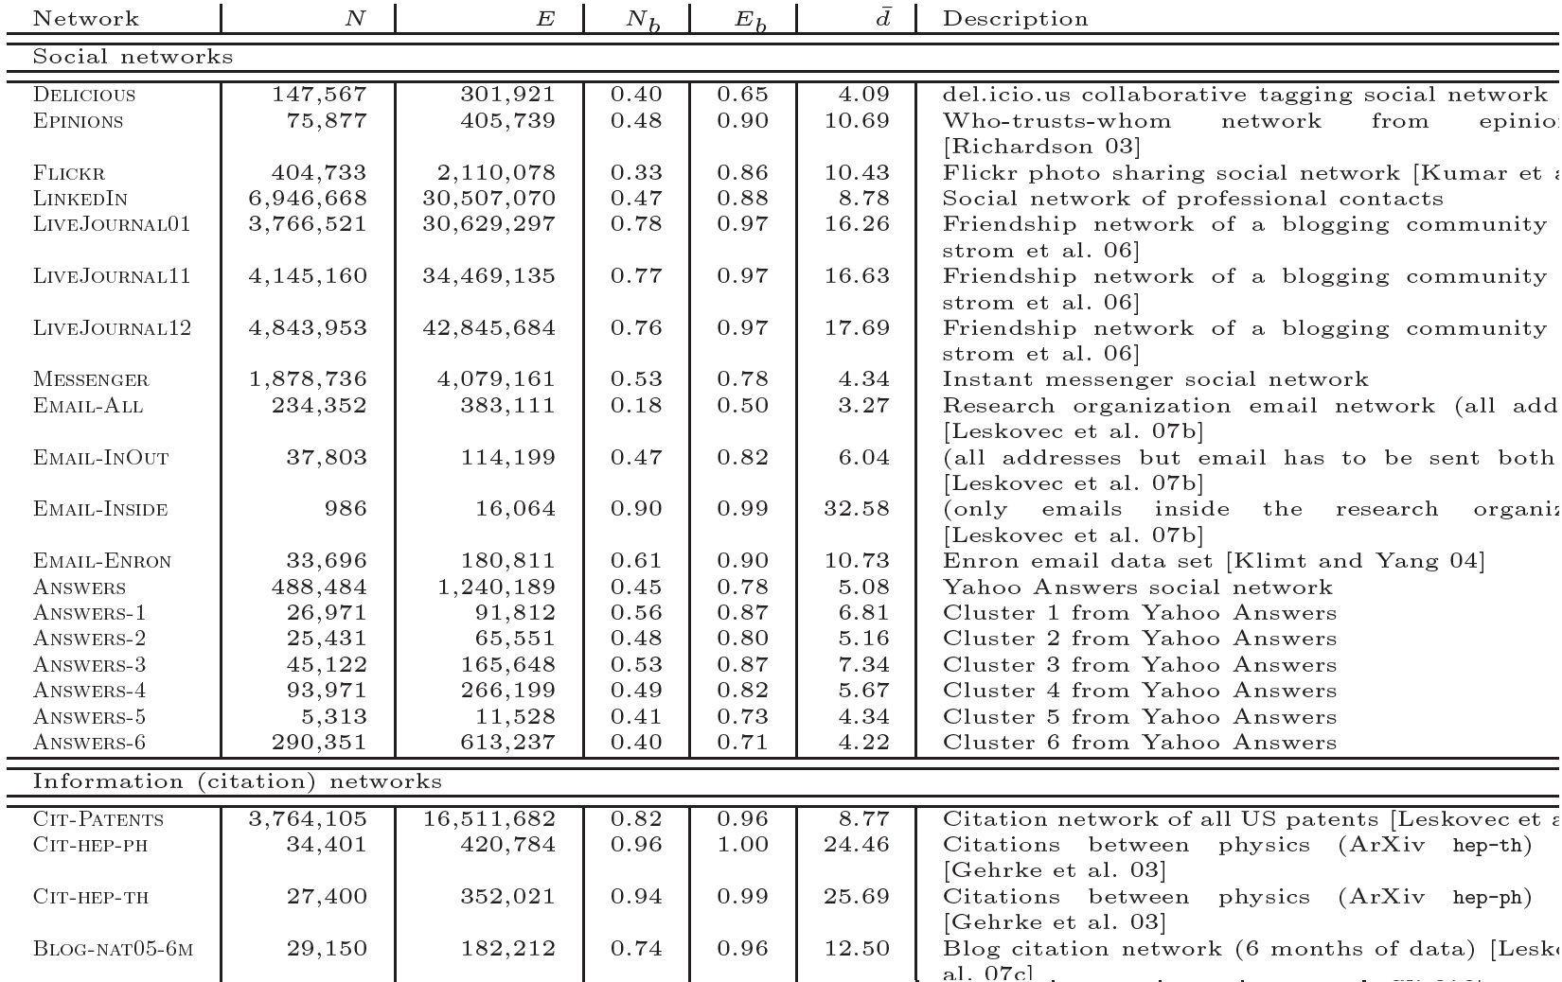
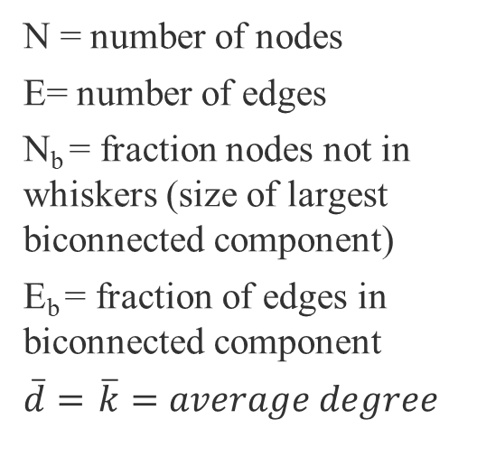
Most real-world networks are sparse
N = number of nodes
E= number of edges
N_{b} = fraction nodes not in whiskers (size of largest biconnected component)
E_{b} = fraction of edges in biconnected component
$\overline{d}=$ $\overline{k}=average degree$
source :Leskovec, J., et al. "Community structure in large networks: Natural cluster sizes and the absence of large well-defined clusters." Internet Mathematics 6.1 (2009): 29-123.

Slide 18
Datasets and Tools
Datasets
http://networkrepository.com/
https://snap.stanford.edu/data/
https://networkdata.ics.uci.edu/
Tools (sorted by priority)
cuGraph: https://github.com/rapidsai/cugraph (Strongly recommend, fast)
NetworkX: https://networkx.org/documentation/stable/tutorial.html (great coverage of graph algorithms)
Snap for Python: http://snap.stanford.edu/snappy/index.html
Pytorch Geometric: https://pytorch-geometric.readthedocs.io/en/latest/
Github project: https://github.com/orgs/hpi-sam/projects/3

Slide 19
END

